Slide 1
Identifying Decision Makers from Professional Social Networks
Speaker: Jim-An Tsai
Advisor: Professor Jia-ling Koh
Author:Shipeng Yu, Evangelia Christakopoulou, Abhishek Gupta
Date:2016/10/25
Source: KDD ’16

Slide 2
Outline
Introduction
Method
Experiment
Conclusion

Slide 3
Motivation

Slide 4
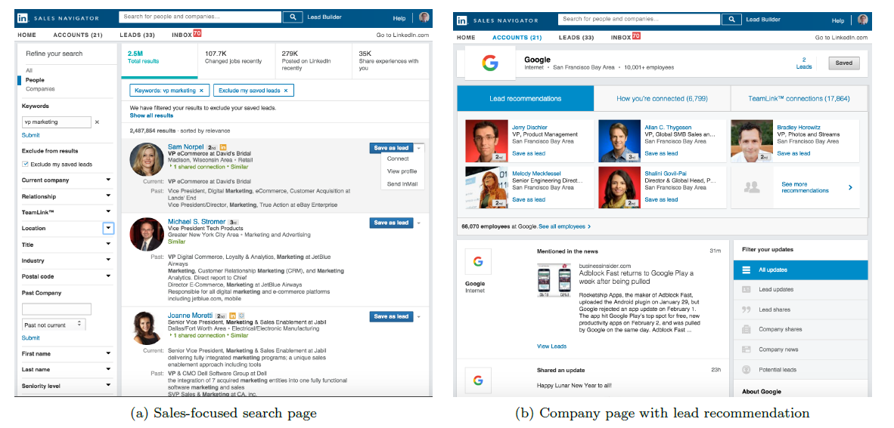
Linked in
Notes:
https://www.linkedin.com/premium/products?displayProducts=&family=sales&c=1032&trk=lss_web_sbd_mktg-me-product_hero_webvid-ft&src=or-search&veh=www.google.com.tw%7Cor-search
https://www.linkedin.com/help/sales-navigator/answer/49981/viewing-and-saving-leads-in-sales-navigator?lang=en
Sales Navigator

Slide 5
Purpose
1. Identifying decision makers in the professional social networks within the LinkedIn ecosystem.
2. Quantify the ability of making a sales decision for each of the 400M+ LinkedIn members.

Slide 6
Framework
LinkedIn.com and LinkedIn Sales Navigator information
Input
Preprocessing
LDMS
Learning Approach
Graph Summarization learning
Bipartite Graph learning
Elastic net classifier
Decision Maker Score of users
Output
Notes:
https://read01.com/jjKmPG.html
http://blog.csdn.net/zouxy09/article/details/24971995

Slide 7
Outline
Introduction
Method
Experiment
Conclusion

Slide 8
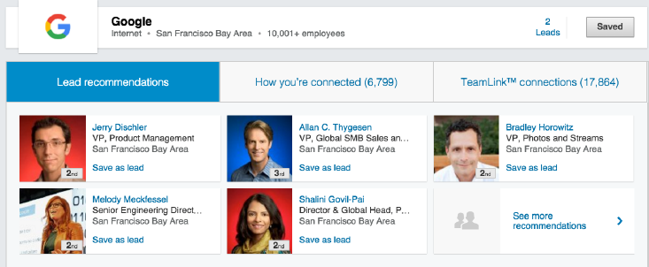
Problem Setting

Slide 9
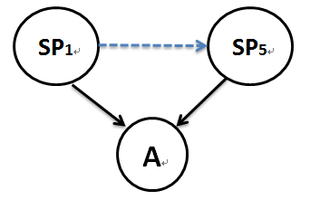
Ground Truth
The key signal
1. Profile View
2. Save as Lead
3. Connection Request
4. inMail
= 5

Slide 10
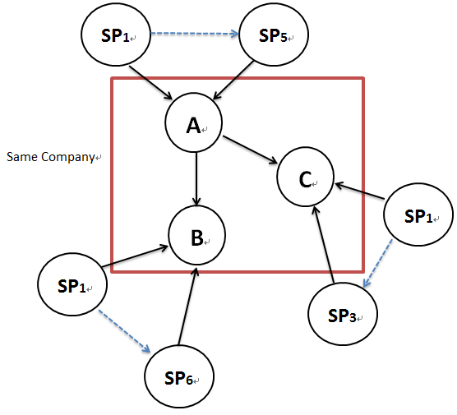
Ground Truth
Discount factors
1. High-outgoing-inMail discount

Slide 11
Ground Truth
2. Peer-comparison discount

Slide 12
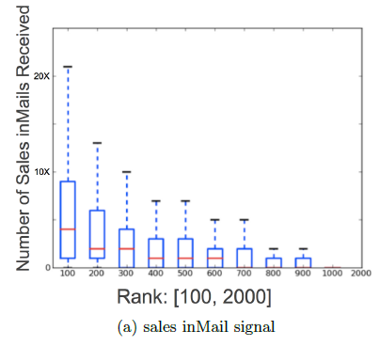
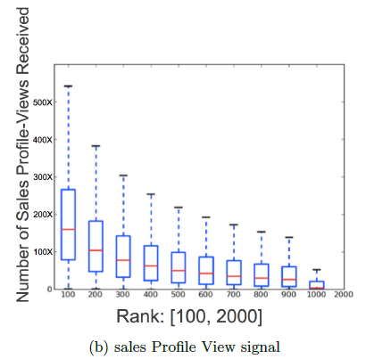
Problem of Sparsity
Notes:
https://zh.wikipedia.org/wiki/%E7%AE%B1%E5%BD%A2%E5%9C%96

Slide 13
Features
1. Member Profile
2. Connection Graph
3. Invitation Graph
4. Profile View Graph
5. Lead Save Graph
6. inMail Graph

Slide 14
Learning with Graph Summarization
Ex: Connection Graph
1. All-Degree
DA = 3
DB = 2
DC = 2
SP = 1
3. Ratio-Sales-All
DA = 1/3
DB = 0
DC = 0
SP = 0
2. Sales-Degree
DA = 1
DB = 0
DC = 0
SP = 0
Notes:
https://www.cs.umd.edu/class/fall2009/cmsc858l/lecs/Lec06-graphsum.pdf

Slide 15
Bipartite Graph Learning
Notes:
http://www.csie.ntnu.edu.tw/~u91029/Matching.html#2
https://en.wikipedia.org/wiki/Sigmoid_function
http://marketing.bankshung.net/2012/03/hits.html
https://en.wikipedia.org/wiki/Heuristic

Slide 16
Outline
Introduction
Method
Experiment
Conclusion

Slide 17
Data Setting
1. Collected all LinkedIn network data over the calendar year of 2015.
2. For offline evaluation we randomly split the LinkedIn member base into training (70%) and testing (30%).

Slide 18
Experiment1
Notes:
https://en.wikipedia.org/wiki/Kendall_rank_correlation_coefficient
http://b20259isgood.blogspot.tw/2014/07/ndcg.html

Slide 19
Experiment2

Slide 20
Experiment3

Slide 21
Outline
Introduction
Method
Experiment
Conclusion

Slide 22
Conclusion
1. Presented LDMS, the LinkedIn Decision Maker Score, to capture the ability to make or influence a buying decision for each of the 400M+ LinkedIn member.
2. Within LinkedIn Sales Navigator, this score is used in refining search ranking, improving lead recommendations and providing additional insights about decision maker activity on LinkedIn.

